Slide 1


Data Analysis Craft Beer: Breweries, ABV/IBU and Other Statistics Prepared by the Cerberus Company
Presentation Video:
https://www.youtube.com/watch?v=_vWOHAwDpAE

Slide 2

Breweries per US State The Number of Breweries In Every US State

Slide 3
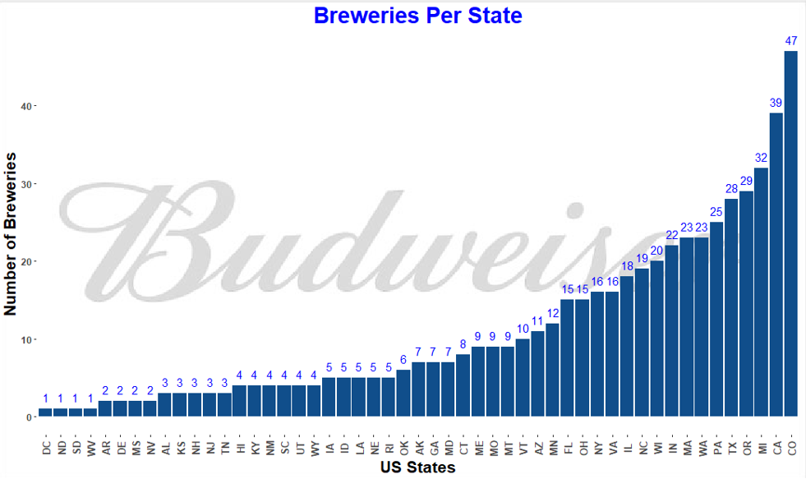
Top 10 states combined contain >50% of all US breweries
Large number of breweries in West (CO, CA, WA, OR)
Notes:
As we can see see here, there’s quite a bit of representation on the west coast, which can be expected based on the microbrewery boom of the past decade. That said, it looks like most breweries are clustered fairly close together, since the top 10 states contain over 50% of all breweries.
We can see here Budweiser’s representation among this distribution – fairly spread out throughout the country while still remaining competitive on the west coast.

Slide 4
Missing Values Dealing with Missing Data

Slide 5
Missing Data
To ensure statistical accuracy, we have decided to remove any data sets that were missing ABV or IBU values. These do not represent full data points for the purpose of the ABV / IBU analysis.
This does result, however, in us removing a beer that would have been reported as the max ABV (Colorado). Since this did not have an associated IBU, we are not considering this data point for our analysis

Slide 6
Measure of Center Median IBU and ABV

Slide 7
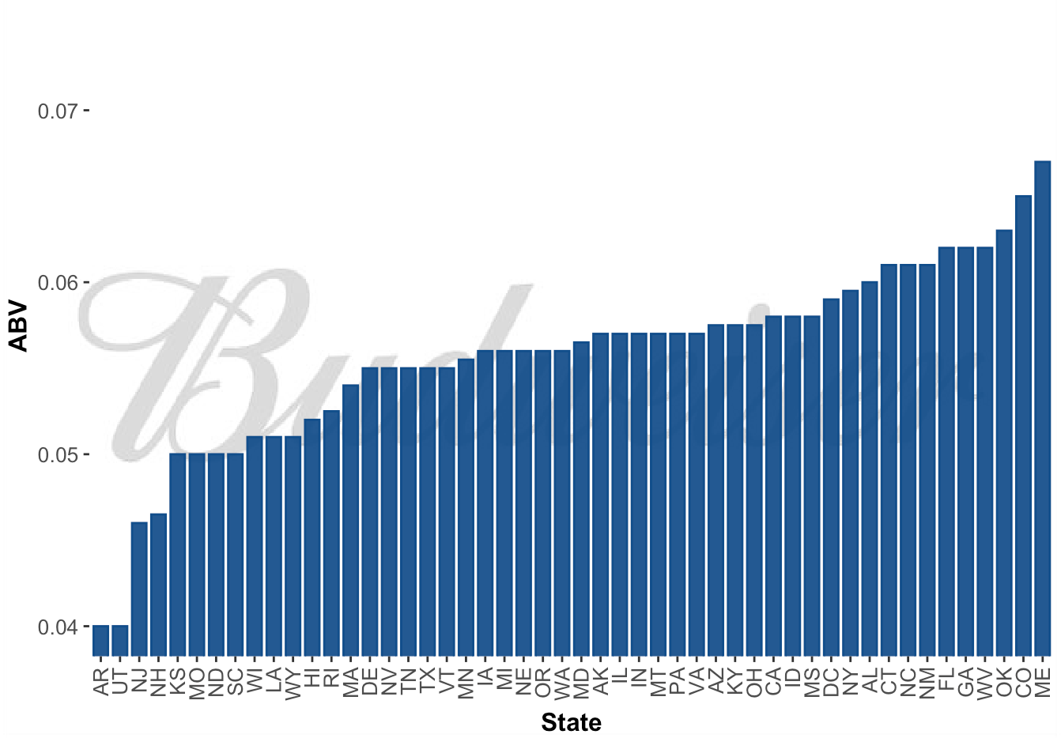
Median Alcohol Content and International Bitterness by State
Notes:
Medians tended to fall around the 5% - 6% range
Which is right where Budweiser falls

Slide 8
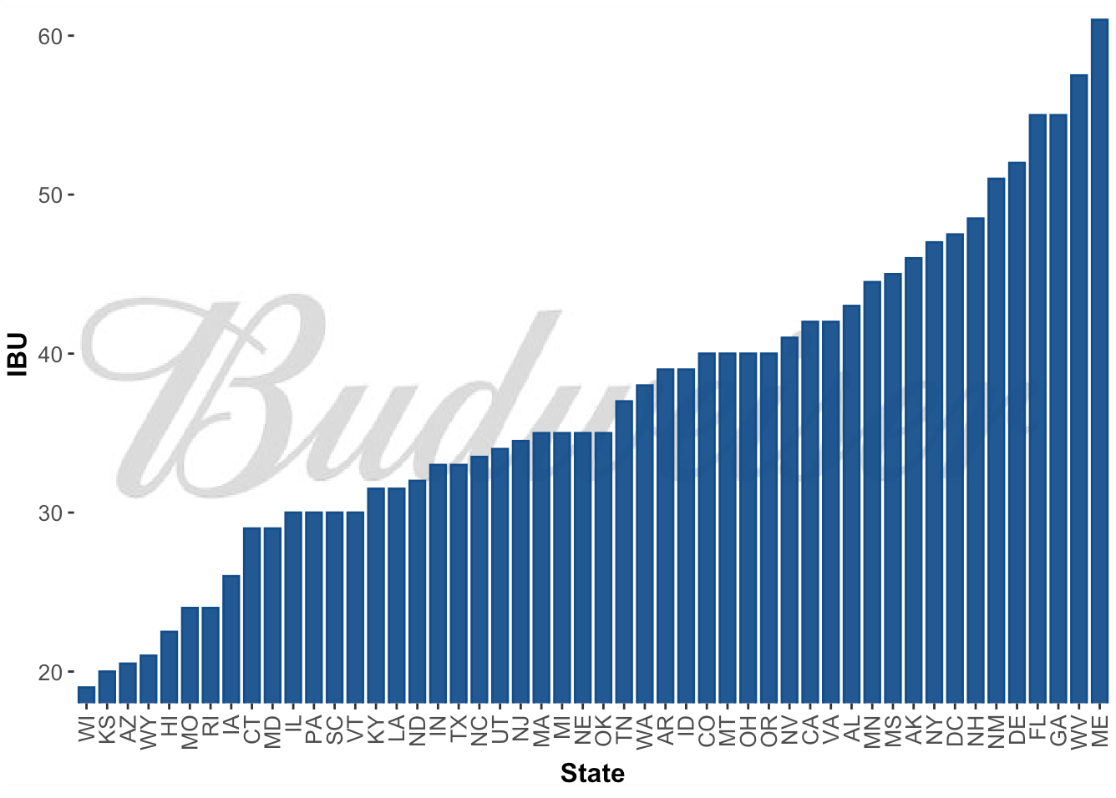
Median Alcohol Content and International Bitterness by State
Notes:
IBU tends to fall 35 – 45 range
Budweiser is at the far low end of this spectrum, which is something that we will explore a little later on

Slide 9
Maximum IBU and ABV

Slide 10
Oregon’s Astoria Brewing Company out of Astoria has the Bitter Bitch Imperial IPA with 138 IBUs; the most bitter beer from our analysis data.
Kentucky’s Against the Grain Brewery out of Louisville has the London Balling English Barleywine with an ABV of 12.5%; The highest ABV beer from our analysis data.
Note: Colorado’s UpSlope Brewing Company out of Boulder has the Lee Hill Series Vol. 5 Quadrupel Ale, with an ABV of 12.8%. However, it has no associated IBU, so is not included in our analysis.

Slide 11
ABV Statistical Summary

Slide 12
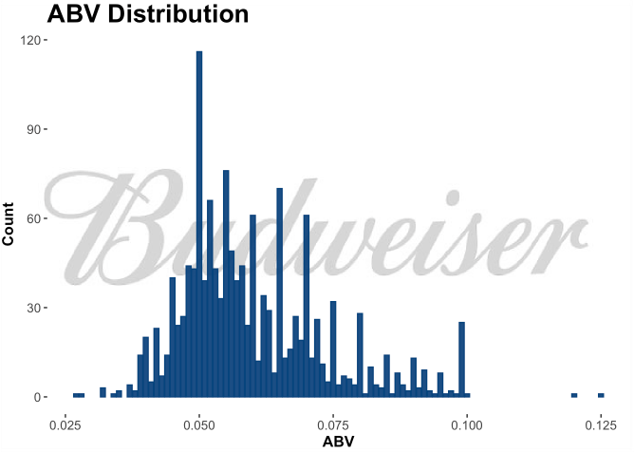
Findings
Evidence of right skewness
Majority of beer falls around the 4.5% - 6% ABV range
Budweiser has an ABV of 5%; falling in the normal range for US Beer
Notes:
Budweiser’s current offerings fall in the range of 2.4% with the Select 55 and the 5% with the classic Budweiser beer.
We can see that there’s clearly demand here that isn’t necessarily currently being met, which presents us with an opportunity that we’ll explore later in this presentation

Slide 13
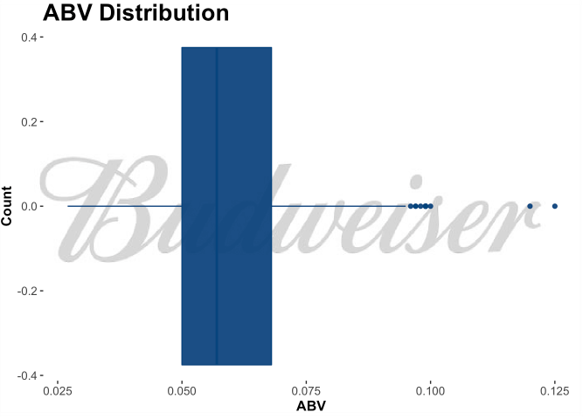
Findings
Min: 2.7%
1st Quartile: 5%
Median: 5.7%
3rd Quartile: 6.8%
Max: 12.5%
Range: 9.8%
Mean: 5.991%
2.4%
Budweiser Select
5%
Budweiser Select 55
4.3%
Budweiser
Note: Summary statistics based on beer data with complete ABV/IBU documentation. Beers not completely documented are not included in these findings.

Slide 14
ABV vs IBU: The Relationship between Alcohol Content and Bitterness

Slide 15
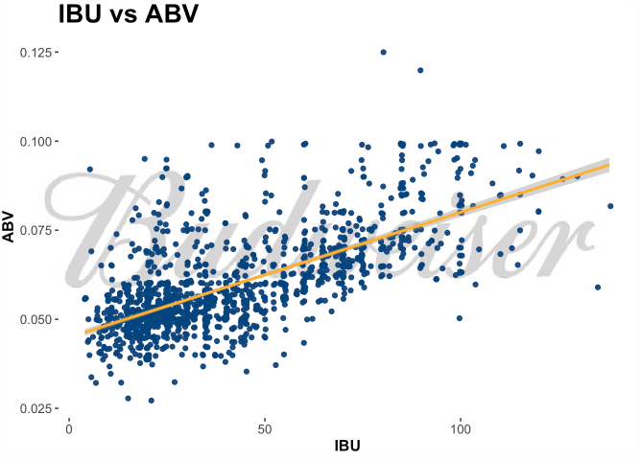
Findings
There is evidence of positive correlation between bitterness (IBU) and alcohol content (ABV).
In general, as IBU increases, an increase in ABV is observed.
Budweiser Beer also follows this trend:
Bud Light 8 IBU, 4.1%
Budweiser 7 IBU, 5% ABV
Black Crown 12 IBU, 6% ABV

Slide 16
IPA vs Ales kNN Modeling to Analyze IBU and ABV trends

Slide 17
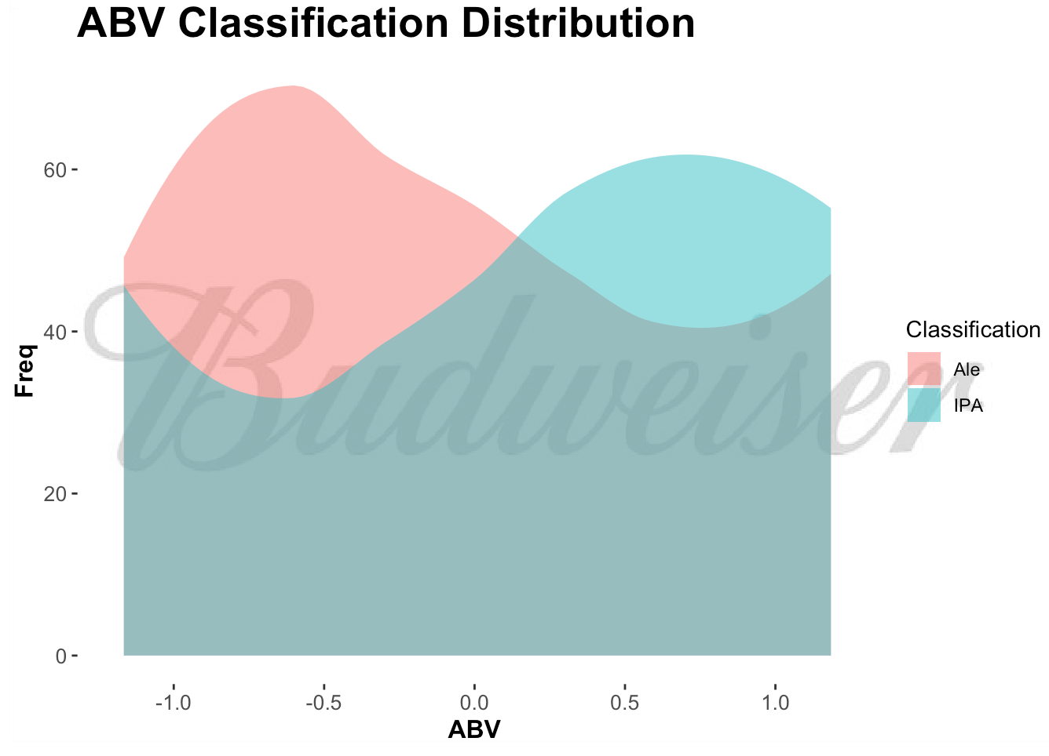
Findings
Optimized kNN Model tended to classify less alcoholic beer as Ale, and more alcoholic beer as IPA.
Conclusion: IPAs tend to have a higher alcohol content than Ales.

Slide 18
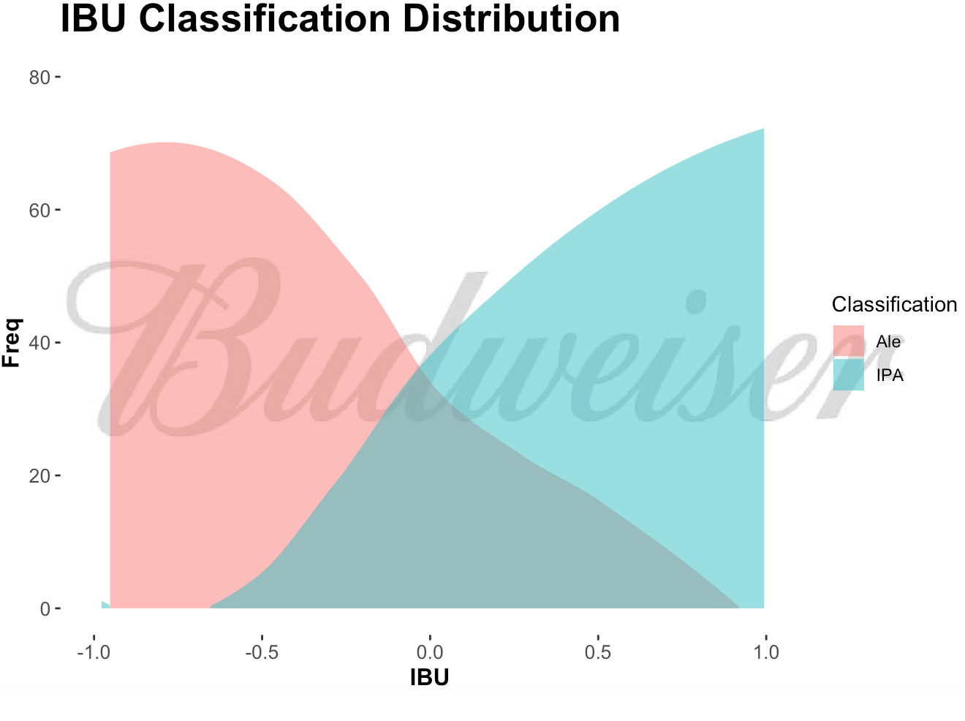
Findings
Optimized kNN model favored IPA classifications for more bitter beer.
Conclusion: IPAs tend to have higher IBU counts, while Pale Ales tend to have lower.

Slide 19
Recommendations: Moving Beyond the Data

Slide 20
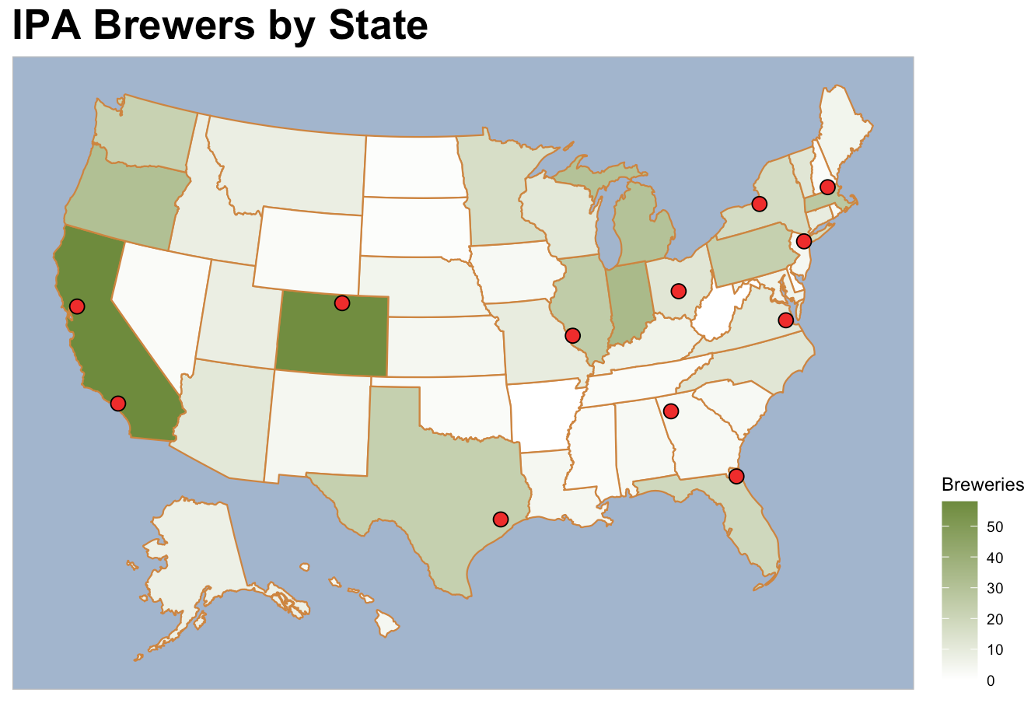
Notes:
Findings
Markets in California and Colorado locations appear oversaturated - it may not make sense to introduce a new Budweiser IPA into these brewing locations
The Texas, Midwest, New England, and Virginia locations all have moderate counts of IPA breweries in the area. This may indicate interest in IPAs by the local populace, and it may be worth investigating further to see if it makes sense to introduce a Budweiser IPA.
The Georgia and Florida Budweiser Breweries are in an area where wither there are almost no IPA breweries, or they are adjacent to this market. It would be worth investigating demand for IPAs in this area. If it exists, it would be strongly recommended to introduce a new Budweiser IPA into these locations to take advantage of this opportunity.

Slide 21
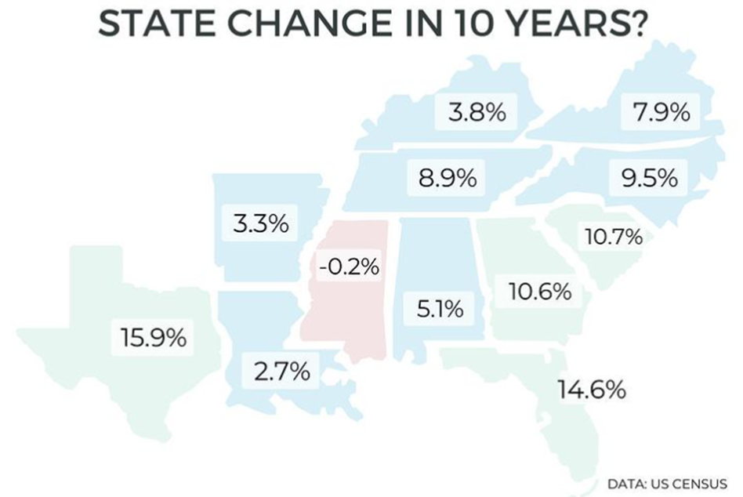
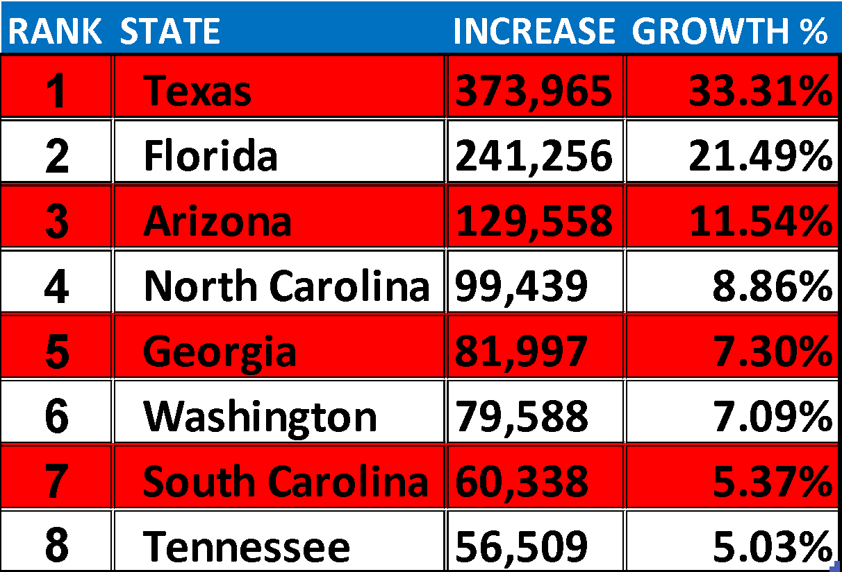
Southeastern states (NC, SC, GA, FL, TN) have all seen strong growth in the past 10 years for a variety of reasons:
Booming housing market – more $$ per sq ft
Lower cost of living
Reduced tax burden
STATE GROWTH: JUL ‘20 – JUL ‘21
This trend has continued through the pandemic, as Southeastern states continue to show significant growth
✰
✰
✰
✰
✰
DATA: https://www.census.gov/

Slide 22
Corporate Tax Rates by State
STATE | CORP TAX RATE | RANK
Nevada | 0.00% | 1
Ohio | 0.00%
South Dakota | 0.00%
Texas | 0.00%
Washington | 0.00%
Wyoming | 0.00%
North Carolina | 2.50% | 2
Missouri | 4.00% | 3
North Dakota | 4.31% | 4
Florida | 4.46% | 5
Colorado | 4.63% | 6
Arizona | 4.90% | 7
Utah | 4.95% | 8
Kentucky | 5.00% | 9
Mississippi | 5.00%
South Carolina | 5.00%
Indiana | 5.50% | 10
Georgia | 5.75% | 11
New Mexico | 5.90% | 12
Michigan | 6.00% | 13
Oklahoma | 6.00%
Virginia | 6.00%
Hawaii | 6.40% | 14
Alabama | 6.50% | 15
Arkansas | 6.50%
New York | 6.50%
Tennessee | 6.50%
West Virginia | 6.50%
✰
Doing Business in the Southeast also makes financial sense – these states have among the lowest corporate tax rates in the country
✰
✰
✰
✰
DATA: taxfoundation.org

Slide 23
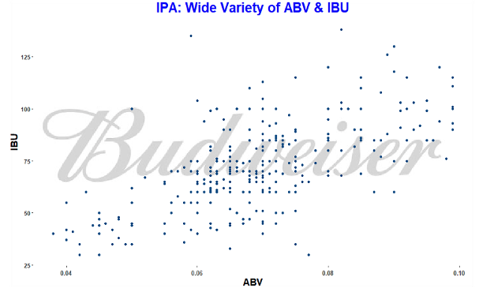
IPA – King of Craft Beer Styles
Largest share of Craft Beer sales
For the calendar year ending December 27, 2020, sales of craft IPAs in retail stores surged 20%, while total craft beer volume grew 13% (IRI)
With a wide range of National ABV/IBU values, IPAs are able to appeal and adapt to the varied tastes of consumers
Notes:
So we’ve explored areas of potential release along with the benefits of doing business here, but we still have the question: “Why an IPA?”
Largest share of craft beer sales - in 2020, IPAs made up a disproportionately large percent of all craft beer sales.
What does this tell us? People want an IPA
Secondly, IPAs have a wide range of flavor and alcohol content. This means that there are a lot of options for introducing a new beer into an unsaturated market like the south east.

Slide 24
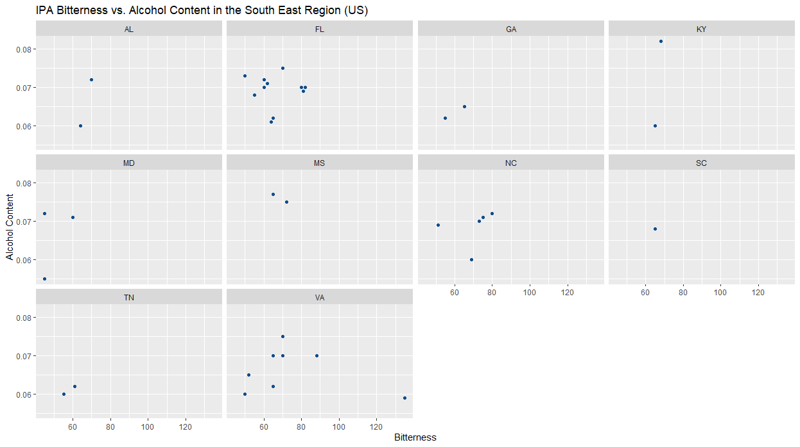
IPA – King of Craft Beer Styles
The Southeast Region of the United States is lacking in options for an IPA
Notes:
Lastly, the southeast is severely lacking in terms of variety for IPAs.
For example, if Budweiser were to test a unique Imperial IPA with higher ABV and IBU.
It would be a novel style in these areas that has we’ve already demonstrated has a high demand based on other markets in the country.

Slide 25
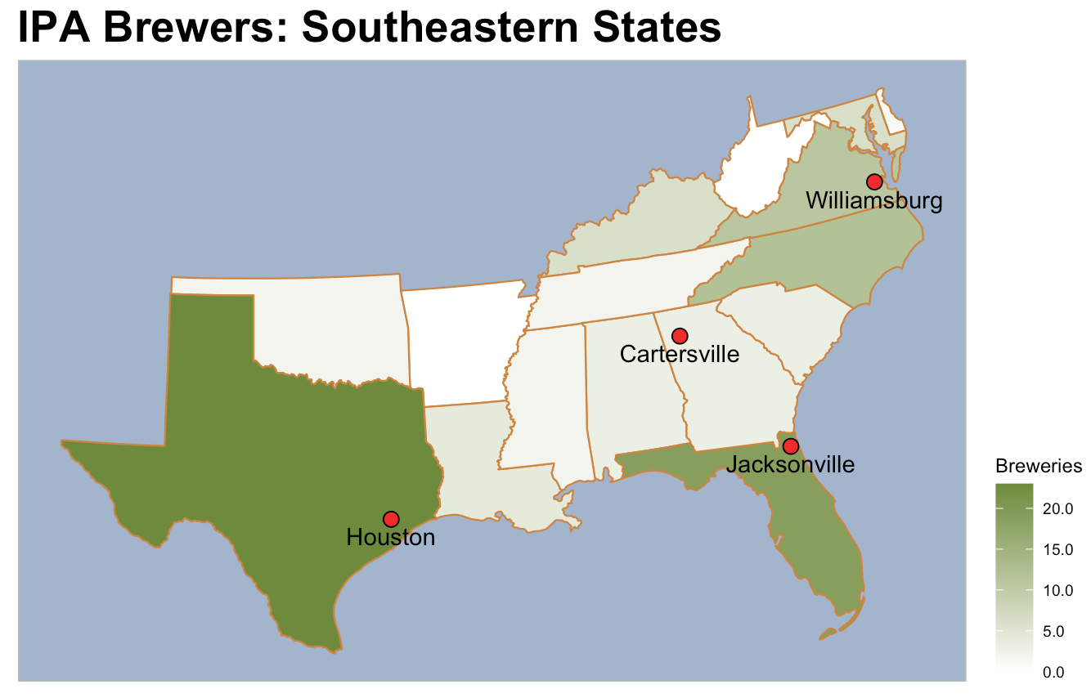
Notes:
Population is growing rapidly in the Southeast region
Southeast states are business-friendly, with lower Corporate tax rates
IPAs are a popular and growing segment within the Craft Beer industry, and the SE is in desperate need of options!
Budweiser has existing breweries in Cartersville, Georgia & Jackson, Florida today
Combine existing synergies, take advantage of regional advantages: Introduce and expand IPA production in Georgia and/or Florida to market to the Southeast region…and beyond

Slide 26
Thank you for your time! Questions?

